Slide 1
Beginnings
Adam Sweeney
CS 211

Slide 2
Introduction
Broad concepts
Chapter 1 from Think Like a Programmer

Slide 3
Agenda
Computer systems
Problem Solving
My First Program
Testing & Debugging

Slide 4
Computer Systems

Slide 5
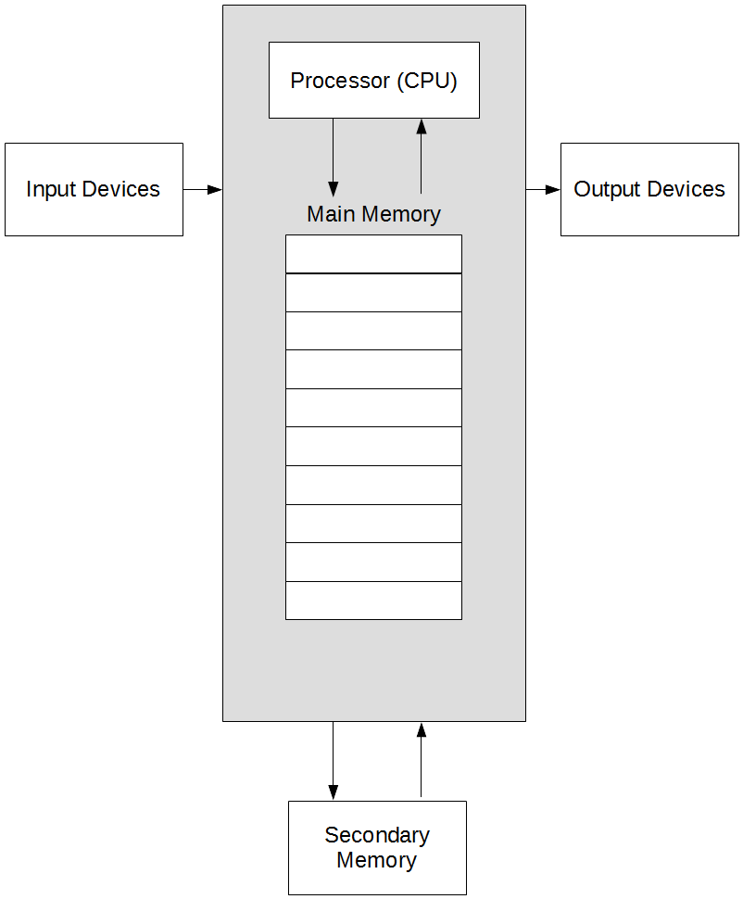
A Computer, Generally

Slide 6
Main Memory
We are going to consider memory as a single entity
Memory is divided into bytes
1 byte == 8 bits
1 bit == 1 xor 0 (bit is short for binary digit)
Every byte has an address (a number)
Usually seen as hexadecimal (0 – F)
0x0, 0x1, …, 0xF, 0x10, etc.
Most data does not fit in a single byte

Slide 7
Data Sizes (abridged)
Type | Size (bytes)
bool, char | 1
int, unsigned int | 4
double | 8
bool
Values of true or false only
char
Single ASCII character
Letter, number, common symbol
int, unsigned int
Whole numbers
Unsigned means 0 or positive only
double
Number with decimal representation

Slide 8
Problem Solving

Slide 9
Thinking Like a Programmer
The hardest part of this course is not writing code
C++ syntax is unfamiliar, not overly complicated
Practice makes perfect
It is producing the solutions to the given problems
The series of steps required to complete a task is called an algorithm
Producing an algorithm will be the tough part (adaptive challenge)
Translating the algorithm to code is easier (technical challenge)

Slide 10
What Doesn’t Work
Throwing code at the compiler
Wastes time
Doesn’t develop critical thinking
Finding code online
Wastes money
How much are paying, and what are you paying for? Learning to learn, critical thinking, problem solving skills, etc? Or how to copy/paste?
Doesn’t internalize syntax or logic, code never gets easier to write

Slide 11
Changing How We Think
Spend a little time reviewing a few puzzles
Each puzzle highlights a different way to approach a problem

Slide 12
Fox, Goose, & Corn
A farmer with a fox, a goose, and a sack of corn needs to cross a river. The farmer has a rowboat, but there is room for only the farmer and one of his three items. Unfortunately, both the fox and the goose are hungry. The fox cannot be left alone with the goose, or the fox will eat the goose. Likewise, the goose cannot be left alone with the sack of corn, or the goose will eat the corn. How does the farmer get everything across the river?

Slide 13
Fox, Goose, & Corn Solution
Take goose across
Take corn across
Take goose back
Take fox across
Row back
Take goose across
Taking the goose back is a counter-intuitive step

Slide 14
Discovering “Hidden” Steps
Restate the problem in your own words
List constraints
Farmer can only take one item at a time
Fox and goose can NOT be left alone
Goose and corn can NOT be left alone
List allowed operations
Being too specific may not offer insights
Try to generalize
Instead of “take fox to far side”, try “load an item in the boat”

Slide 15
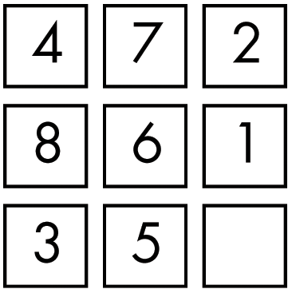
Sliding Tile
Notes:
Is the whole solution plain to see?

Slide 16
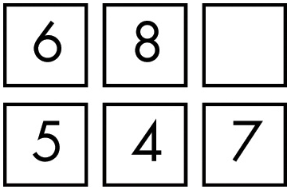
Break the Problem Down
Is this puzzle easier or harder?

Slide 17
Mountain Climbing
Climbers typically don’t approach a mountain with the plan “Get to the top”
Planned stops, routes to each stop
The sum of the smaller plans results in reaching the top of the mountain
Don’t approach a problem with the mindset of solving it all at once
Break it down into smaller problems
Break those down
Keep going until you have a series of small tasks that get you where want to be

Slide 18
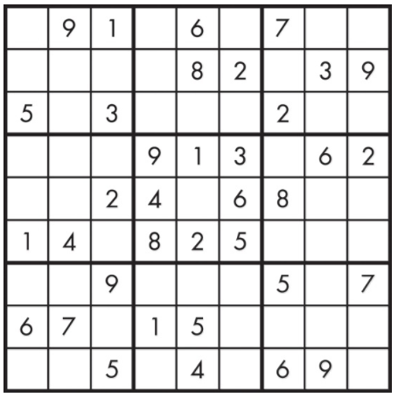
Sudoku
Notes:
Where to start?

Slide 19
Pick the Best Starting Point
Start where your problem is the most constrained
Solve where you are the most limited first
Corollary, start with the most obvious part

Slide 20
Quarrasi Lock
An alien race, the Quarrasi, has landed on Earth, and you’ve been captured. You’ve managed to overpower your large, tentacled guards, but to escape the spaceship, you must open the massive door. The instructions for opening the door are, oddly enough, printed in English. To open the door, you must slide the three bar-shaped Kratzz along tracks that lead from the right receptor to the left receptor, which lies at the end of the door, 10 feet away.
That’s easy enough, but you must avoid setting off the alarms, which work as follows. On each Kratzz are one or more star-shaped crystal gems known as Quinicrys. Each receptor has four sensors that light up if the number of Quinicrys in the column above is even. An alarm goes off if the number of lit sensors is ever exactly one. Note that each receptor’s alarm is separate: You can’t ever have exactly one sensor lit for the left receptor or for the right receptor. The good news is that each alarm is equipped with a suppressor, which keeps the alarm from sounding if the button is pressed. If you could press both suppressors at once, the problem would be easy, but you can’t since you have short human arms rather than long Quarassi tentacles.
Given all of this, how do you slide the Kratzz to open the door without activating either alarm?

Slide 21
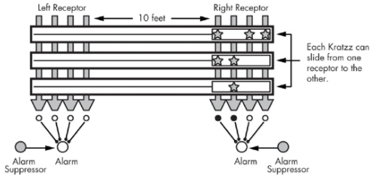
Visualization of Quarrasi Lock

Slide 22
The Simple Solution
We’ve already solved this problem
The constraints are identical to fox, goose, & corn
New problems, or sub-problems may be solved already if we’ve encountered them before
The more problems we solve, the more problems we will be able to solve

Slide 23
General Problem-Solving Techniques
Always have a plan
Restate the problem
Divide the problem
Start with what you know
Reduce the problem
Look for analogies
Experiment
Don’t get frustrated
Notes:
“When you allow yourself to get frustrated—and I use the word “allow” deliberately—you are, in effect, giving yourself and excuse to continue to fail. […] Also, when it comes down to getting frustrated or taking a break, you should take a break.” Excerpt from Think Like a Programmer

Slide 24
My First Program

Slide 25
Testing & Debugging

Slide 26
Types of Errors
Syntax
Improperly written code; compiler will catch these and emit an error or warning
Run-time
Program compiles, but crashes while executing
Logic
Program compiles and runs, but output is not correct

Slide 27
Debugging
Use of a debugger will not be taught in this course
There is already enough content
Easiest “tool” for this course will be printing to screen
Next best is pen & paper execution
Cheatsheets/links for using debuggers will still be provided

